Slide 1

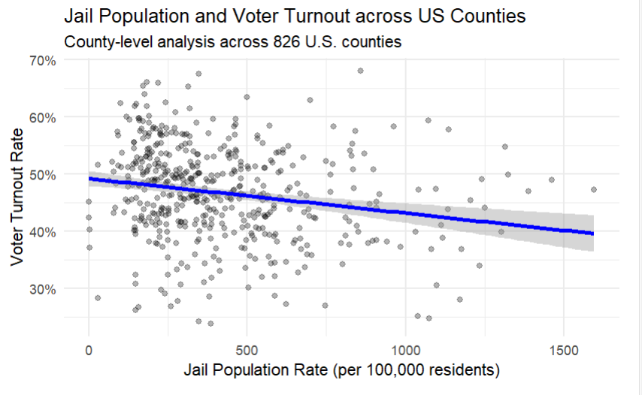
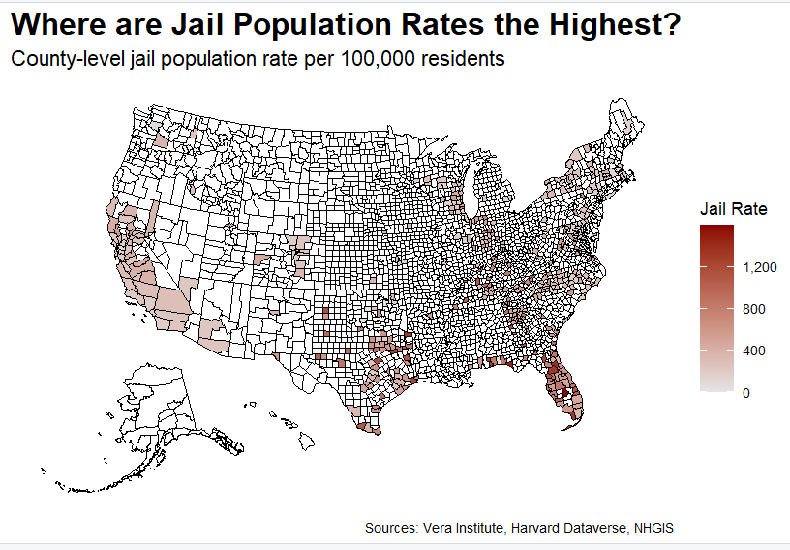
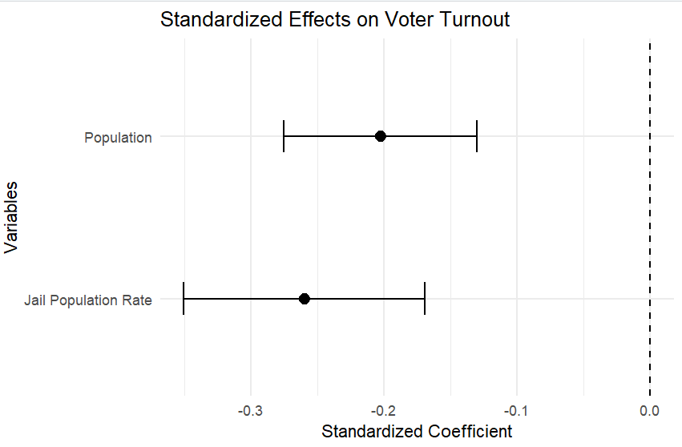
Mass Incarceration and Civic Participation
Exploring the Relationship between County Incarceration and Voter Turnout in the United States
Conor de Leeuw
Data Analytics and Computational Social Sciences
Abstract
Data/Methodology
Conclusion
This project explores the relationship between incarceration rates and voter turnout at the county level in the United States during the 2024 presidential election. The study examines whether counties with higher incarceration rates exhibit lower voter turnout. The project utilizes visualizations and regression analysis to examine how incarceration may influence voter turnout after accounting for basic population characteristics.
Data
1. Vera Institute of Justice
2024 County incarceration rates
Jail population measures
Historical incarceration trends
2. Harvard Dataverse – countypres_2000–2024
County-level presidential election returns
Filtered to 2024 election turnout data
3. IPUMS NHGIS / American Community Survey
Basic population characteristics
All datasets were merged using county FIPS codes
Analysis
County level FIPS merge
Linear regression models
Scatterplots
Mass incarceration may reduce civic engagement
Communities with higher incarceration rates exhibit lower political trust.
Geographic inequality remains visible
Civic outreach and voting education may improve participation.
Counties with higher incarceration rates generally report lower voter turnout. The relationship appears strongest in parts of the Southern United States.
Introduction
Results
Incarceration direct affects individuals within the prison system, and its effects may extend to families, communities, and neighborhoods . One area where these impacts may occur is in civic participation, particularly in voter turnout:
Why this matters
Mass incarceration affects political participation
Formerly incarcerated individuals face voting barriers
Communities with higher incarceration may experience lower voter turnout
Incarceration can also weaken social networks that help spread encouraging voting behavior.
Higher incarceration associated with lower voter turnout.
Geographic clustering stronger in the South.
Regional differences have a role in turnout variation
Statistically significant after controlling for population.
Exposure to institutions has more impact.
Research Question
To what extent are higher incarceration rates associated with lower voter turnout across U.S. counties?
Sub-question: Which regions are most affected by both incarceration and civic underrepresentation?
Counties in the southern U.S show higher incarceration rates than in the Northwest. Incarceration rates are not evenly distributed across the US.
Standardized regression coefficients suggest that higher jail population rates are associated with lower voter turnout, even after accounting for population differences

